Slide 1
Choose your new borough
Boroughs comparaison using Kmeans clustering

Slide 2
Introduction
This work aims to help a friend to chose his future work place
He has opportunity to join his company’s office in New York, Toronto or Montreal
He likes his living environment in Paris
He wants to find the borough that will be closest to his current Paris 11e arrondissement (borough)

Slide 3
Data
4 Dataset listing each cities boroughs are availables (see reports)
Those dataset are enhanced with borough coordinates thank to to geopy.geocoders library.
Foursquare API is used to retrieve the main venues of each borough

Slide 4
Methodology
Sklearn Kmeans clustering is used to dispatch boroughs in 5 clusters based on venues categories.
The objective is to compare Paris’s borough to borough of New York, Toronto and Montreal

Slide 5
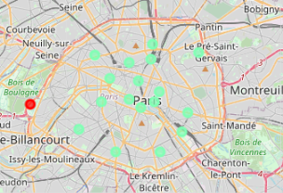
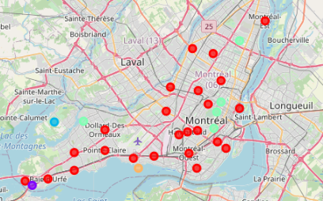
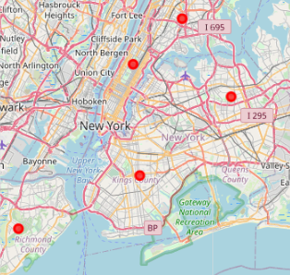
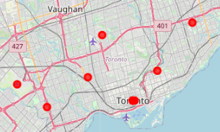
Resultats

Slide 6
Results
As we can see in the above capture, Montreal is the closest to Paris in terms of venues.
So my friend should choose Monreal to have better chance to retrieve his living environnement he has in Paris.

Slide 7
Resultas
In addition to choosing Montreal, my friend should choose among Montreal 5 borough that are closest to Paris’s 11e arrondissement: Le Plateau-Mont-Royal, Mont-Royal, Westmount, Pierrefonds-Roxboro or Anjou.

